Slide 1
Country buyer Quantity placement
COBM Projects only
2022
Notes:
The notes that accompany these example slides form a guideline to producing successful presentations and working effectively with the template. A number of slide layout masters have been created to allow switching between different slide styles and options. By ‘right-clicking’ a slide and choosing ‘new slide’ you will open the layout master of the slide.
Printing your presentation in ‘black and white’ will avoid overuse of colour toners – you can preview the ‘black and white’ appearance by choosing the option under the ‘View’ tab in PowerPoint.
General principles
Guides have been added to assist with the correct placement of all presentation elements (text and graphics) – please work within the slide margins and use the guides wherever possible. You can hide and show the guides through the ‘View’ tab. By following the example slides you will see how elements are positioned. Text should not be resized or distorted to fit; if your content won’t fit on a single slide, use an additional slide instead. Default font sizes should not be adjusted. Remember… slides should be a prompt for the presenter and not filled with copy for reading out in full.
To create a new presentation, please choose the master template and save the opening presentation with the name required. You can delete the slides you will not need from the left bar.
Title slide [uses Title Slide Layout option when you create a new slide from the ‘Home’ ribbon]
The background colour, brand mark and graphic device on this slide layout are preset and should not be altered.
The date and footer info can be edited across all slides by using the ‘Header and Footer’ settings on the ‘Insert’ ribbon (do not edit these manually on the individual slides or in the master view).

Slide 2
How to place Quantities as a country buyer?
You have been invited to participate in an international common sourcing project.
Your task is to place quantities based on your country’s sales potential.
Project leader will provide you with all product information including detailed article description, product quality and price indication.

Slide 3
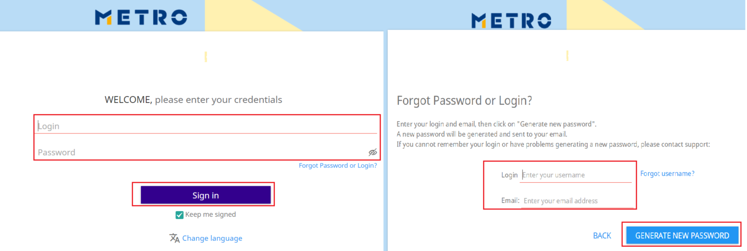
eSourcing login
Please click on the eSourcing link in the invitation email: https://esourcing.metro-link.com
Enter your Login (usually your email address) and Password, then click on Sign in.
If you would need a new password, please click on Forgot Password or Login?
Please provide your Login and Email address.
Click on Generate new password to receive an email with a new password.

Slide 4
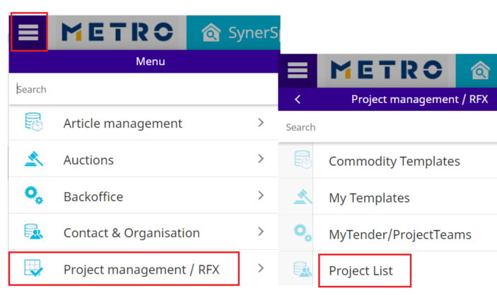
Find your project
You can access your project via:
Project management/RFX-Project List
SynerSpace

Slide 5
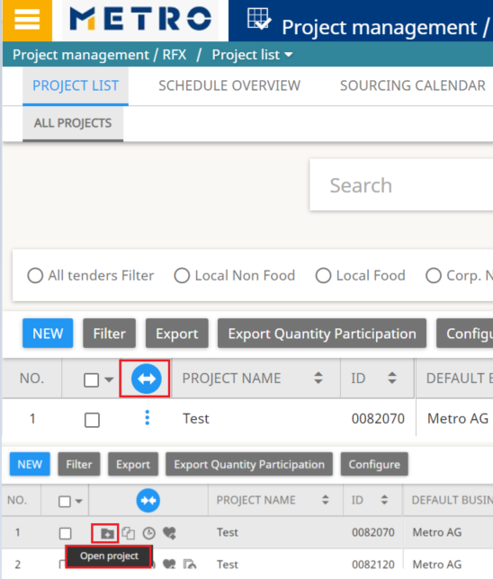
click on OPEN PROJECT
Click on the blue arrow to expand and find the Open project icon
Click on Open project icon to access the needed project.
You will find the project details, as: project name, ID, project leader’s name

Slide 6
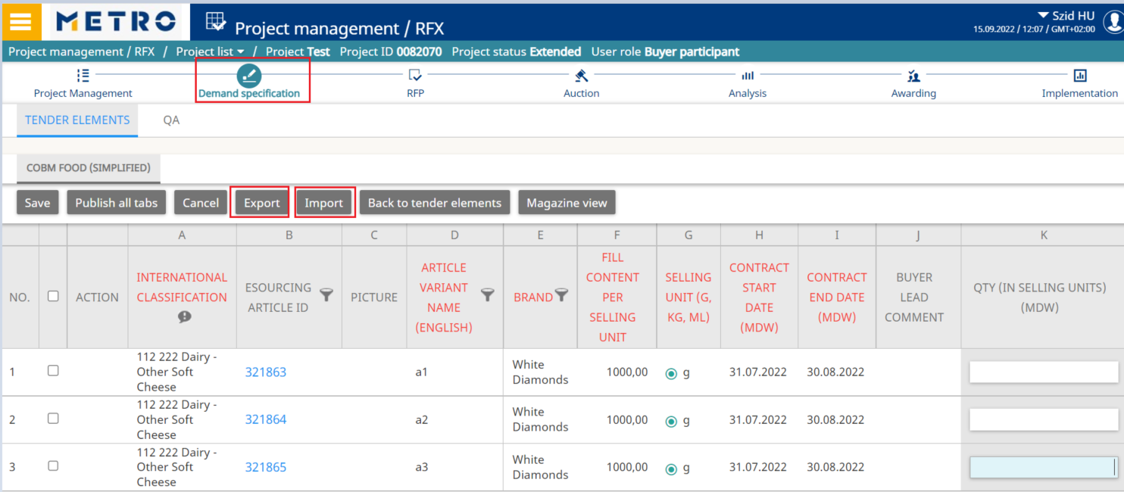
click on Demand specification
Click on Demand Specification tab to provide your quantities.
You can use Export and Import functionalities to place your quantities.
Please do not change the format of the exported file.

Slide 7
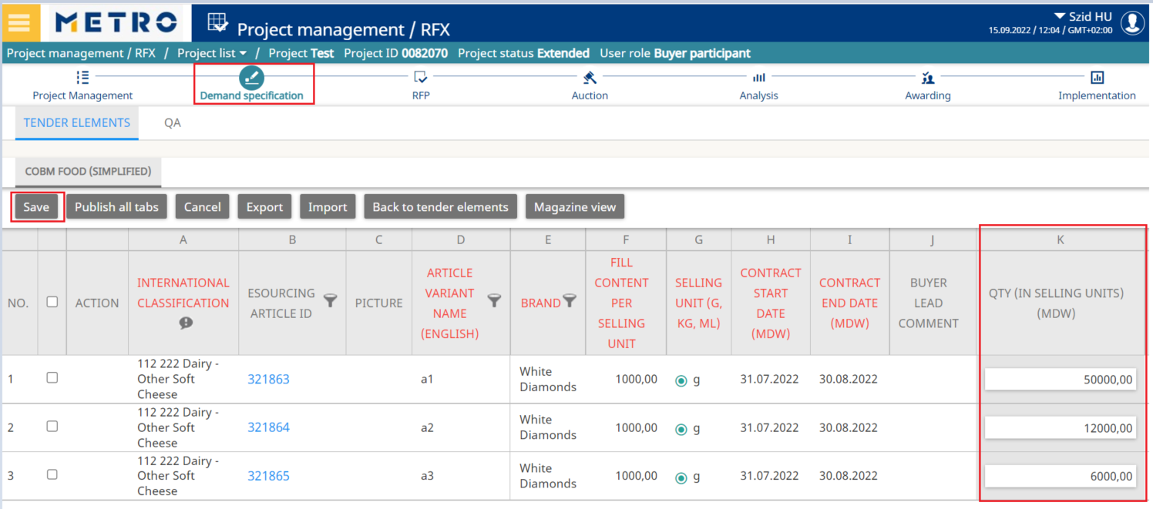
Click on save
Provide your values in the Quantities (In Selling Units) column
Save your input.

Slide 8
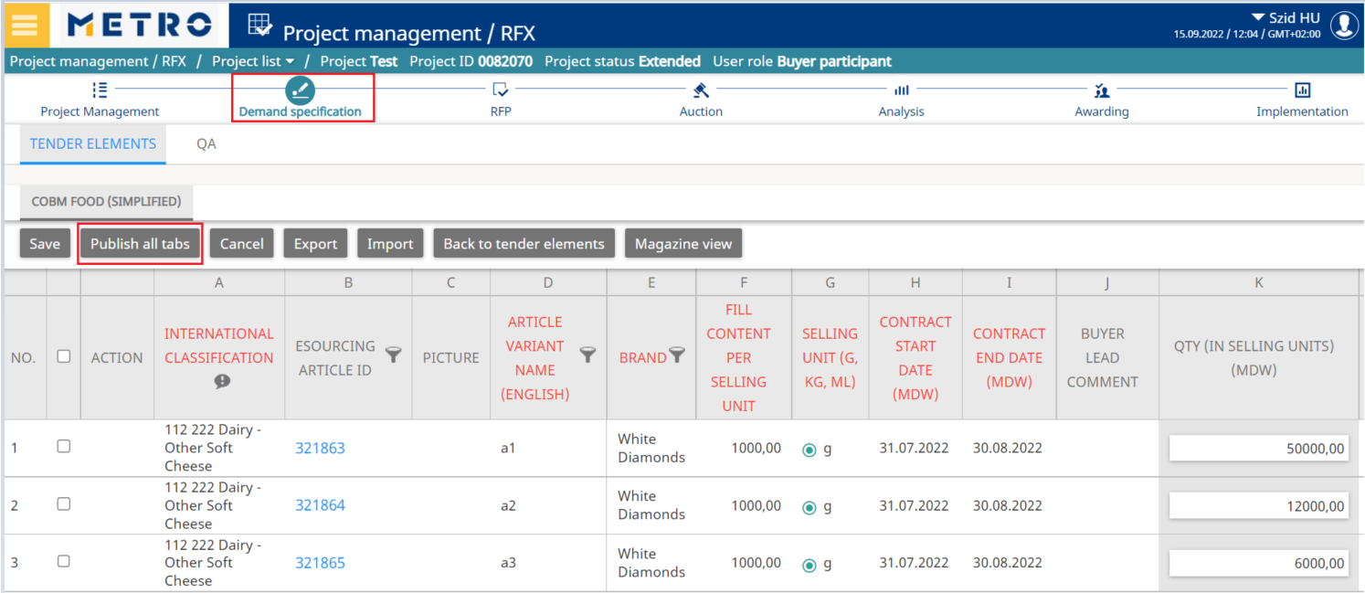
Click on Publish all tabs
Click on Publish all tabs icon for your answers to be visible for the buyer.

Slide 9
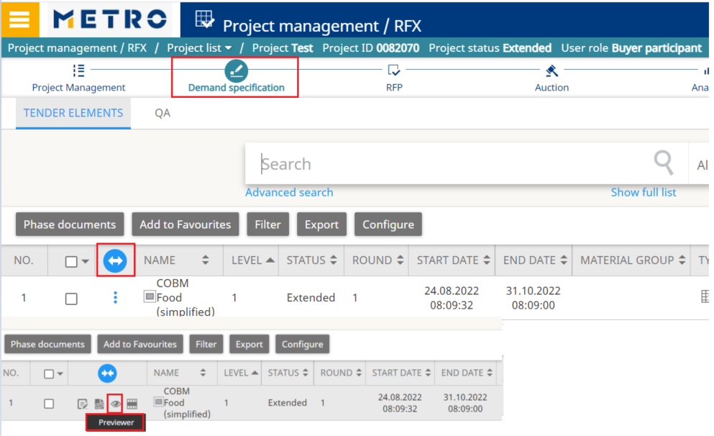
Previewer
If you will click on Back to tender elements tab, you will find Place values and Previewer
Previewer icon allows you to check the quantities you have placed previously.

Slide 10
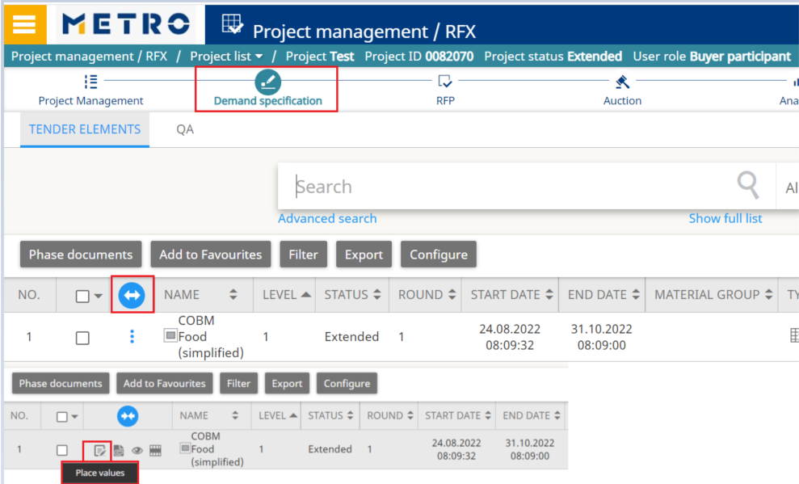
Place values
Place values icon will allow you to change your quotation while the project is still open.
Project status needs to be: Online/Extended

Slide 11
CONTACTS
Process Consulting Offer Solutions
Hotline: +49 211 969 4747
Mo. – Thu.: 08:00 to 18:00 CET
Fri.: 08:00 to 16:00 CET
esourcing@sourcingsupport.de
Notes:
Contacts slide [uses Contacts Layout option when you create a new slide from the ‘Home’ ribbon]
The background colour, brand mark and graphic device on this slide layout are preset and should not be altered.
The title appears in Verdana Bold 36 pt upper case (white); other contact details should be in Verdana (white) as shown in this example. The contact information appears in Verdana Regular 15 pt (white) as shown.

