Slide 1
COBM _PROJECT SUPPORT FOOD PROJECTS
COBM Projects only
2022
Notes:
The notes that accompany these example slides form a guideline to producing successful presentations and working effectively with the template. A number of slide layout masters have been created to allow switching between different slide styles and options. By ‘right-clicking’ a slide and choosing ‘new slide’ you will open the layout master of the slide.
Printing your presentation in ‘black and white’ will avoid overuse of colour toners – you can preview the ‘black and white’ appearance by choosing the option under the ‘View’ tab in PowerPoint.
General principles
Guides have been added to assist with the correct placement of all presentation elements (text and graphics) – please work within the slide margins and use the guides wherever possible. You can hide and show the guides through the ‘View’ tab. By following the example slides you will see how elements are positioned. Text should not be resized or distorted to fit; if your content won’t fit on a single slide, use an additional slide instead. Default font sizes should not be adjusted. Remember… slides should be a prompt for the presenter and not filled with copy for reading out in full.
To create a new presentation, please choose the master template and save the opening presentation with the name required. You can delete the slides you will not need from the left bar.
Title slide [uses Title Slide Layout option when you create a new slide from the ‘Home’ ribbon]
The background colour, brand mark and graphic device on this slide layout are preset and should not be altered.
The date and footer info can be edited across all slides by using the ‘Header and Footer’ settings on the ‘Insert’ ribbon (do not edit these manually on the individual slides or in the master view).

Slide 2
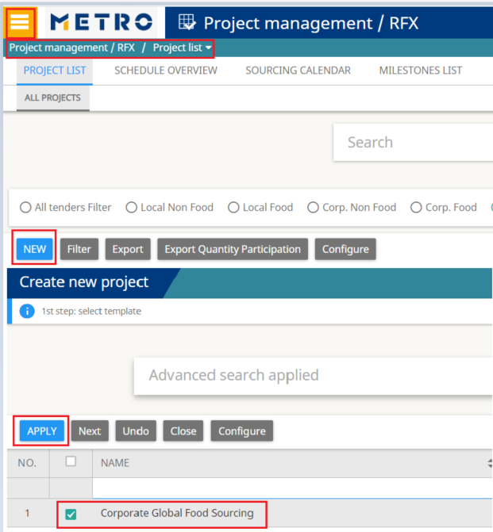
HOW TO CREATE A NEW CORPORATE FOOD PROJECT
Click on Project management/RFX-Project list
Click on New
Search and select template
Corporate Global Food Sourcing
Click on Apply

Slide 3
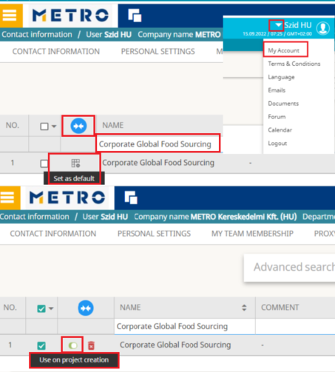
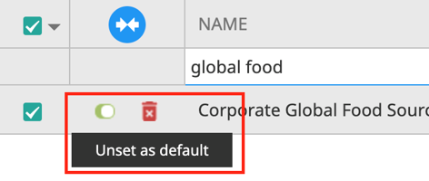
HOW TO set corporate global food sourcing template your default template
Click on My Account
Click on My tender templates
Search for Corporate Global Food Sourcing template
Click on Set as default
Click on Use on project creation
From now on when you will create a new project
the system will automatically select for you the
defined template
This way you will be sure that you selected the correct template and also will mean less clicks in the project creation
This option can be changed with Unset as default icon

Slide 4
Project management-project details
Project Details:
Fill in all mandatory fields marked with red
Click on Save
Project naming convention:
MAG_ARO_Canned Peached Q1 2021

Slide 5
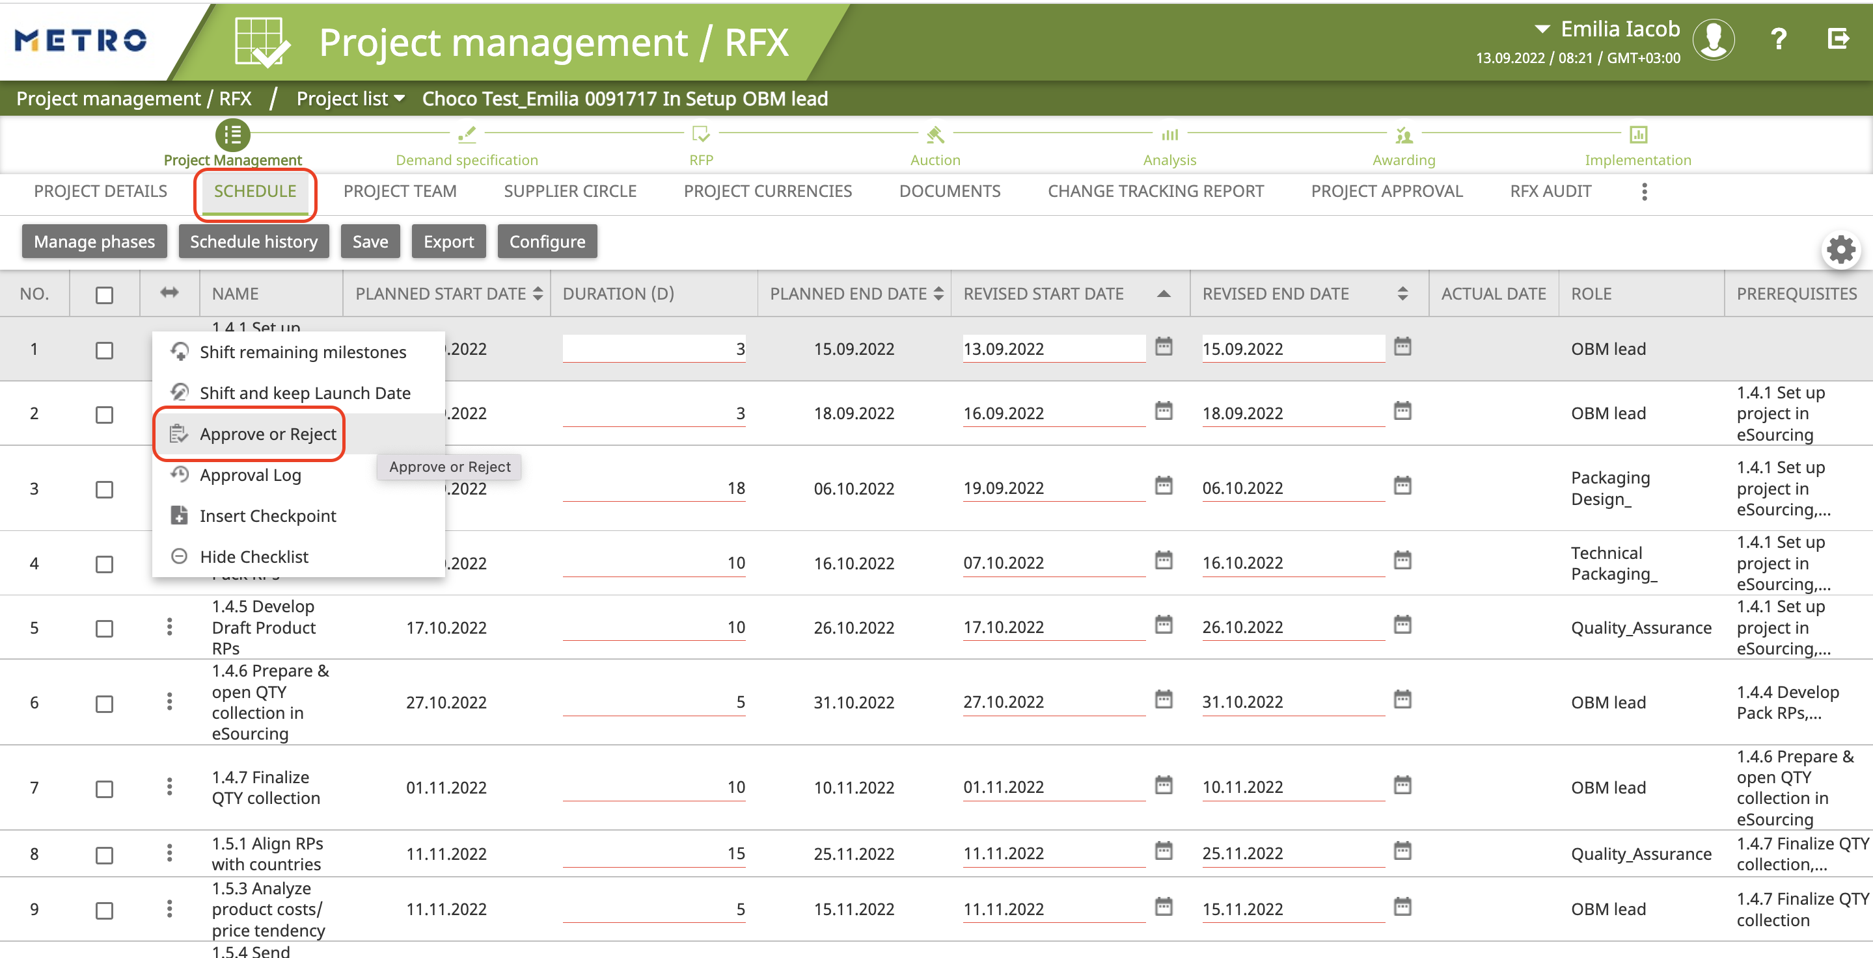
Project management-SCHEDULE
Schedule is automatically created in the new project.
It showcases the project timeline with all its steps (milestones).
Click on Schedule
Milestones & responsible roles are listed
Approve or reject a milestone (alteanatively, use Project Approval tab)
Once a milestone is approved/rejected, the actual date is inserted in the system and other users will be informed by email that milestones is approved/rejected.
IMPORTANT: Updating the milestone status in eSourcing simultaneously with real life project events is extremely important because only this update will trigger the next steps and therefore impact the entire project timeline.

Slide 6
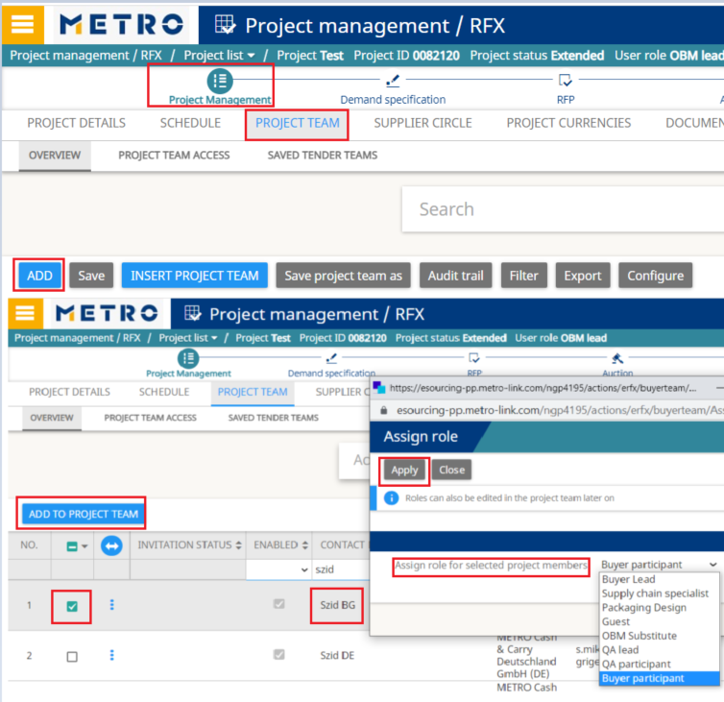
Project management-project team add icon
Project Team: invite your team
Click on Add-find and select the user
Click on Add to project team
Select the role of the user
Click on Apply
Roles:
OBM Lead: You, the project leader, who created the project
OBM Substitute: Has same rights as the project leader
Buyer participant: Country buyers
Guest: Has only viewer right on the project

Slide 7
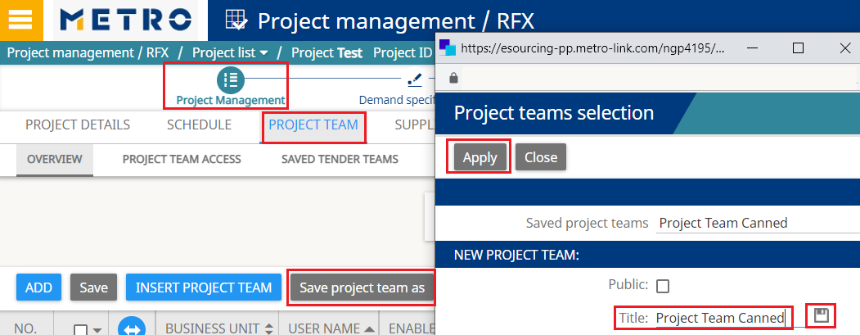
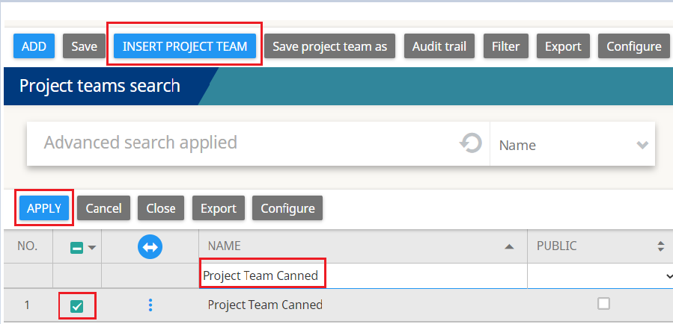
Project management-project team create & insert project team
Create your project team
Add the users
Click on Save project team as
In the pop-up give a title for your team
Click on the save icon
Click on Apply
Insert your project team (in a new project)
Click on Insert project team
Search and select your team
Click on Apply

Slide 8
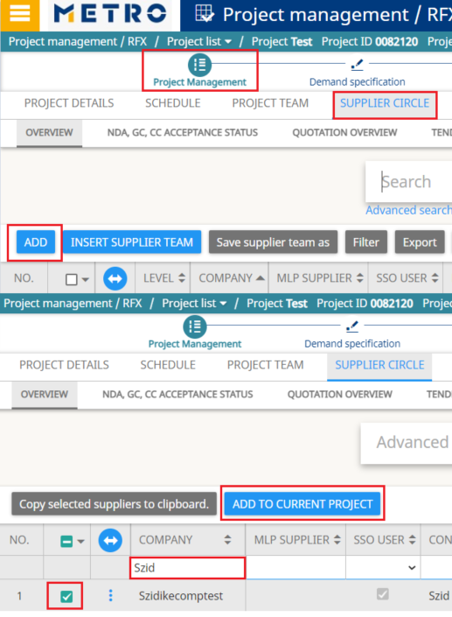
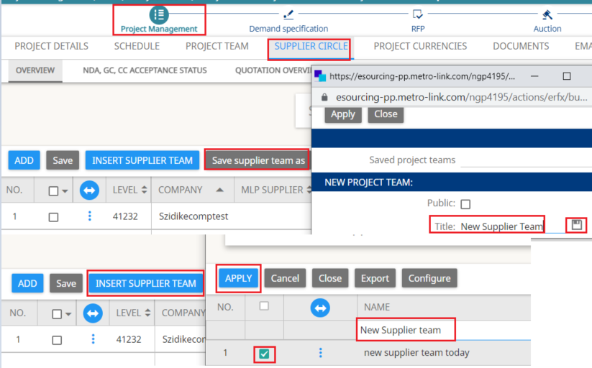
Project management-supplier circle Existing supplier
Supplier Circle: Invite your supplier
If the supplier is already existing
in the Supplier database click on
Add-select supplier-Add to current project
Save supplier team/Insert Supplier Team
Similar as for Save/Insert project team

Slide 9
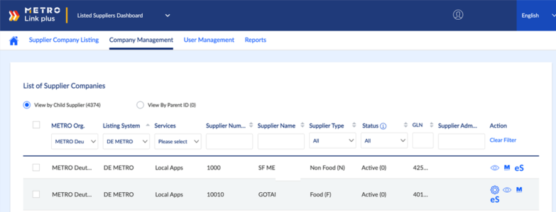
Project management-supplier circle NEW supplier-REGISTRATION VIA METRO LINK PLUS
If the supplier is NOT existing in the Supplier database, you will need to onboard the company and users via the Metro Link Plus platform.

Slide 10
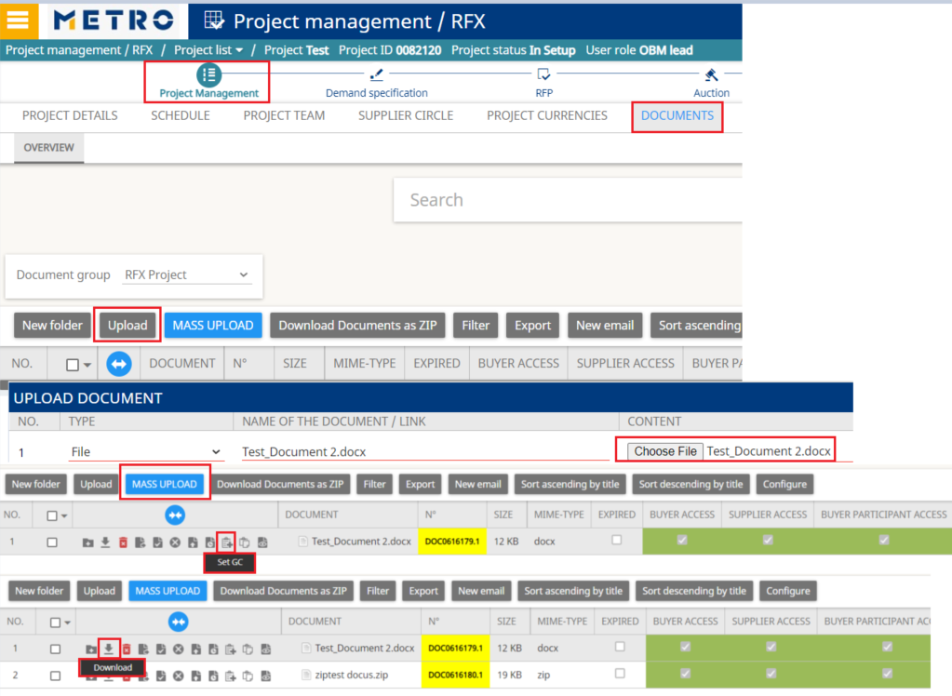
Project management-documents
Upload:
Set GC icon allows you to set your document as General Condition
Mass Upload:
You can attach a zip file, containing several documents
We recommend to use this option if you have several documents that should be set as GC
The supplier will be able to accept them with one download
Who can see the documents?
Buyer access: Buyers
Supplier access: Suppliers
Buyer participant access: Country buyers
Download:
You can download and see the documents uploaded by other users for you

Slide 11
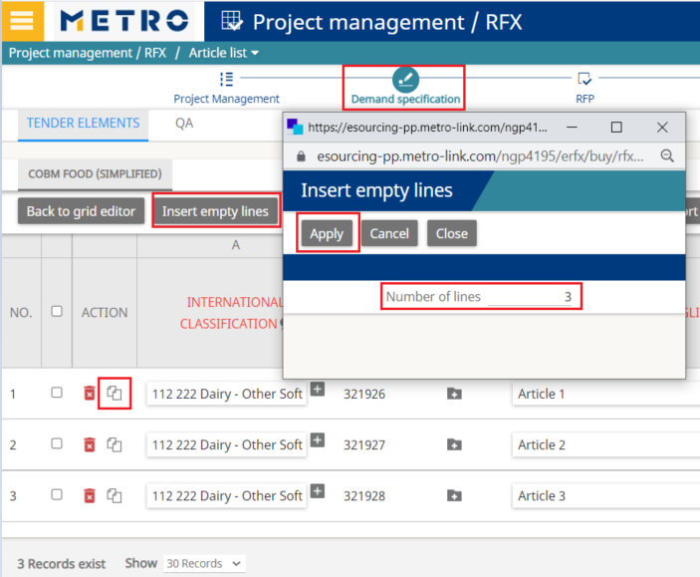
Demand specification-add new article
Insert empty lines
Number of lines: number of new articles
Click on Apply
The system will generate the new eSourcing IDs
Fill in all mandatory fields marked in red
Article naming convention:
Brand/English article description/fill quantity
Ex: Aro_Canned Peach 3100 ml
Copy Values:
you can copy the data from
an article to another, as
brand/contract start, end date

Slide 12
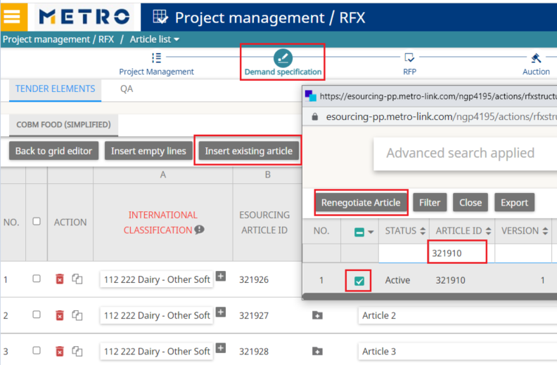
Demand specification-add existing article
Insert existing article
If the article was already created, you will need to renegotiate it
Condition: the article needs to be awarded
Search and select the article ID
Click on Renegotiate Article
Article status explanation:
Active: article was awarded, can be renegotiated
In development: article is included in a project, not yet awarded
Deleted: article ID cannot be used
Expired: previous active version

Slide 13
Demand specification-publish
Start your quantity collection
Click on Demand Specification
Click on BU view
BU view: Articles & participating business units
Click on Publish
Click on Next in the pop-up
Set the End date of your grid using the calendar
Project status will change from In setup into Online
Country buyers will provide their quantities
If needed, you will be able to Extend the project

Slide 14
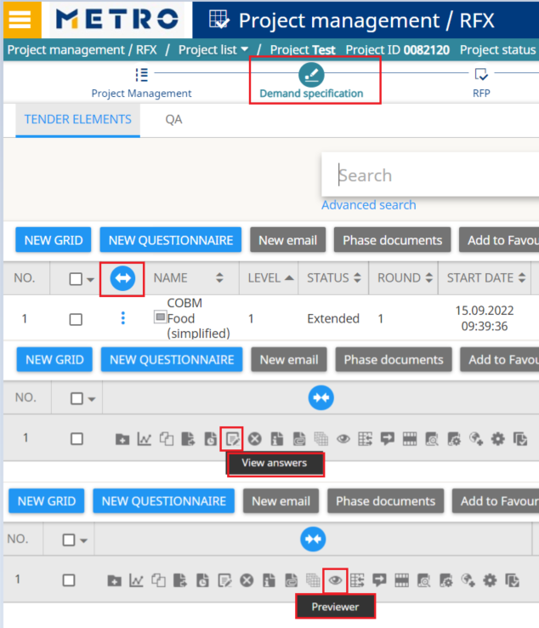
Demand specification-check received answers
Click on Previewer
Here you can see received answers by country
Select role view: Buyer participant
Select business unit: country
Click on View answers
Here you will see all received answers

Slide 15
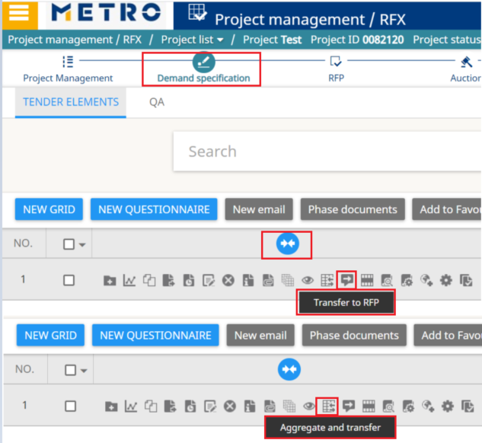
Rfp-created from demand specification
Click on Transfer to RFP
Quantities will be transferred individually (per BU) to RFP
In this case the supplier can provide a price per BU
Click on Aggregate and transfer
Quantities will be transferred aggregated/summed up per each article to RFP
One price per article for all BUs
The RFP can be created in several ways:
Transfer Demand Specification into RFP
Transfer to RFP or Aggregate and transfer
Create a new grid
Create the RFP out of a grid from an accessible (earlier) project

Slide 16
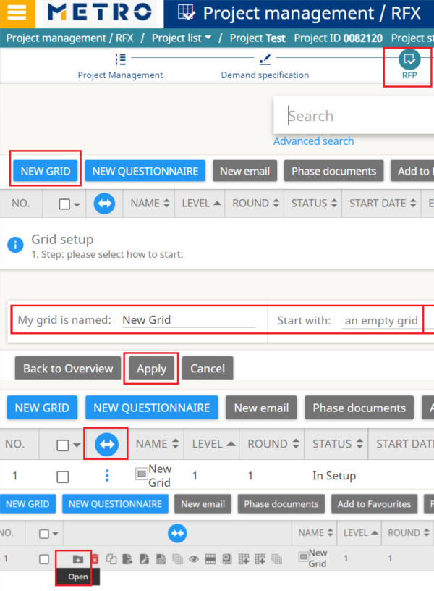
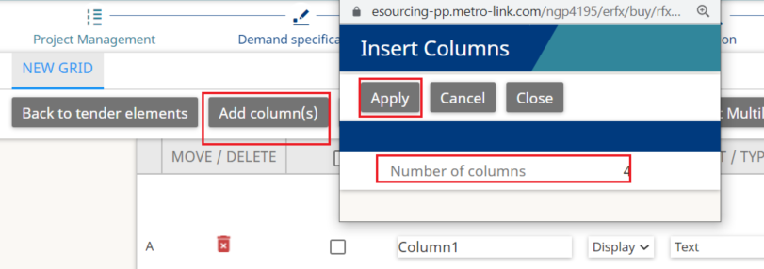
Rfp-create a new grid
Create a new grid:
Click on RFP (Request for Price)
Click on New Grid
Start with an empty grid
Click on Apply
Create the columns:
Click on Open
Click on Add column(s)
Define Number of columns
Click on Apply

Slide 17
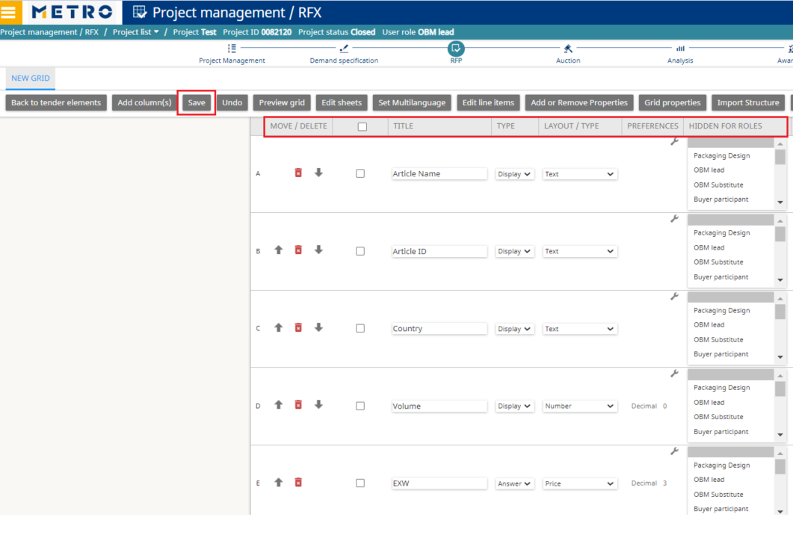
Rfp-define your columns
Title: name your columns
Display Type: Supplier will see the column
Answer Type: Supplier will be able to give an answer in that column
Layout: can be Text/Price/Number etc.
Click on Save, then Edit line items
Create the lines:
Click on Insert empty lines
Define the number of lines=no. of articles
Click on Apply
Fill in the grid manually in the page or you can use Export grid/Import lines

Slide 18
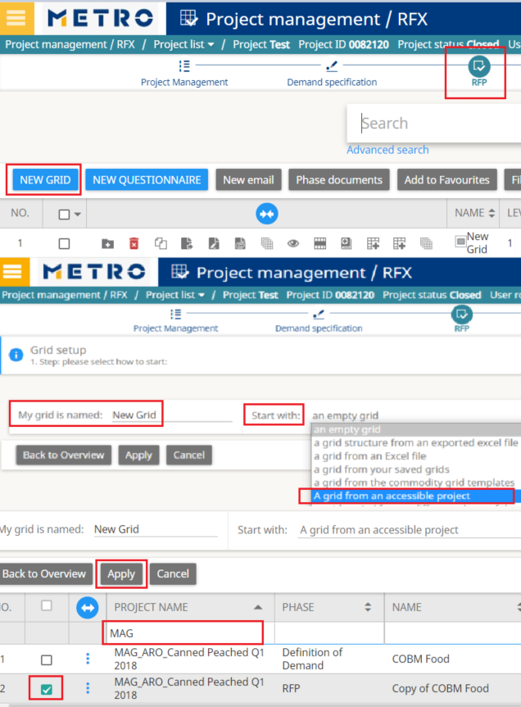
Rfp-created from an accessible project
Click on RFP
Click on New grid
Select: A grid from an accessible project
Search for the old project by name
Select the RFP phase and click on Apply
You will have a new RFP In setup, with copied data from selected earlier project

Slide 19
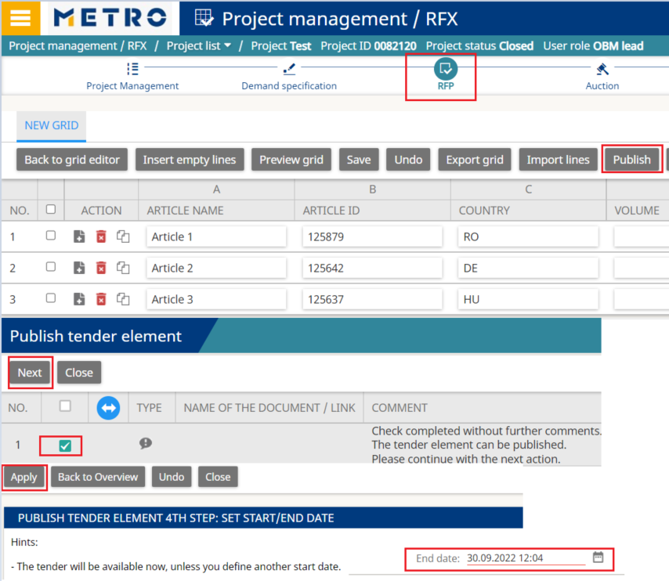
Publish RFP: Data passed to Suppliers
Click on Publish
Select the line and click on Next
Your RFP will start now-if checkbox is ticked
Set End date for the RFP-use the calendar, click Apply
RFP will have status Online
You can set for the RFP a different starting time
You will see status: Ready (not Online)
Ready status will change into Online at the set time
Invited suppliers will be able to participate in the RFP
Check received answers: View answers & Previewer

Slide 20
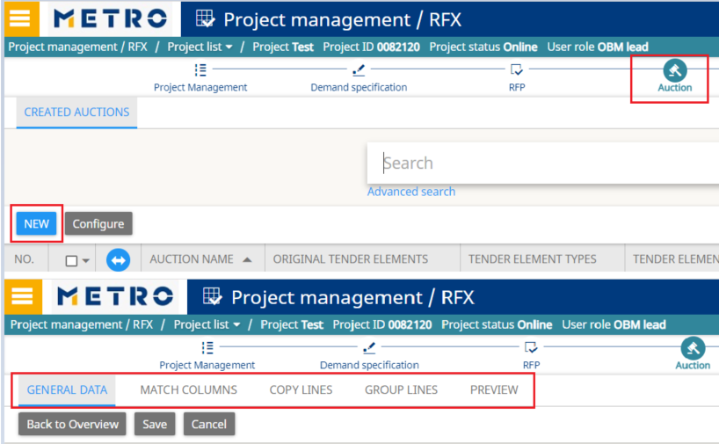
Auction creation (Optional)
Transfer RFP into AUC
Click on Auction
Click on New
You will go through the 5 steps of auction creation
Fill in General data, Save
Match Columns-Select grid(s), Apply
Click on Edit
Fill in mandatory fields marked with red, Save
Copy Lines, Save
Group Lines
Preview, Apply
You will be prompted to the auction module, to finalize your auction set up
Auction types: English/Dynamic; Japanese; Dutch

Slide 21
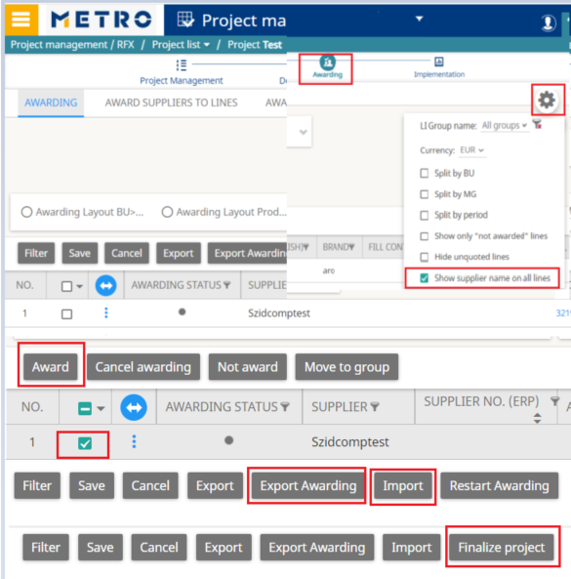
Awarding: Prerequisite for GTIN assignment
Within the awarding part we define which supplier(s) are awarded for an article (needed step also for audit reasons)
Please make sure that prices were maintained under Demand Specification before starting the awarding
Project statuses for awarding: Closed/Analysis
Click on Awarding
Click on Display settings
Click on Show supplier name on all lines
Use: Award button or Export awarding/Import
After awarding project status will change to Awarding in process or Awarded
Finalize project icon allows you to change the project status from Awarding in process into Awarded
After the articles are awarded, GTINs can be assigned by the packaging specialist

Slide 22
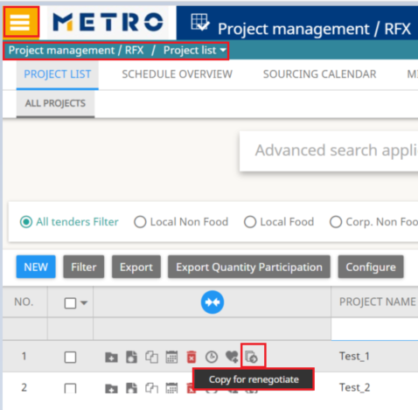
Copy for renegotiate
All common sourced articled should be tracked via GTINs, so we can see the profitability of the Own Brand articles on article level.
MDW is providing reports in order to be able to see these information and be able to take the best business decisions.
After the project was awarded, you can use the Copy for renegotiate function in order to renegotiate the project
You will be able to choose what information you would like to keep in your new project from project team/supplier circle/demand specification, etc.

Slide 23
Project maintenance request from oss
Project maintenance assistance can be requested from OSS
For this the attached excel template will be filled by the buyer and sent to esourcing@sourcingsupport.de
Maintenance time within 2 weeks, depending on workload
Mandatory information to be provided in the excel file:
Project name and ID number (project needs to be created by the buyer)
Project leaders name
Articles eSourcing ID; if new article, please mention New in the ID column; full name in English; International Classification; brand; fill content per selling unit; selling unit;
Contract start and end date
Quantity/volume information if needed to be maintained will be provided per country and per articles
Price information: Previous Buying Price and Final Buying Price (EXW, EUR)
Previous Buying Price/Price 1:
For new articles this info is not available
For renegotiated articles it is the final price from the previous project
Final Buying Price/Price 2:
Final negotiated price from current project
Could come from RFP/Auction/Face to face negotiation
One price 1 and one price 2 can be maintained per article/per country (BU/Business Unit)

Slide 24
CONTACTS
Process Consulting Offer Solutions
Hotline: +49 211 969 4747
Mo. – Thu.: 08:00 to 18:00 CET
Fri.: 08:00 to 16:00 CET
esourcing@sourcingsupport.de
Notes:
Contacts slide [uses Contacts Layout option when you create a new slide from the ‘Home’ ribbon]
The background colour, brand mark and graphic device on this slide layout are preset and should not be altered.
The title appears in Verdana Bold 36 pt upper case (white); other contact details should be in Verdana (white) as shown in this example. The contact information appears in Verdana Regular 15 pt (white) as shown.

