Slide 1
Revionics Reporting
5 October 2021

Slide 2
Agenda
Navigation basics
Hints, Tips & FAQ’s
Dashboards & Summary
Pricing Reports
Export History & Compliance
Operational Reports (Exceptions)
Planning - Scenario Explorer
Sales Reports
Value Measurement
Appendix: Methodology Used

Slide 3
Navigation
Accessing reports
Navigating folders
Running a report

Slide 4
Accessing Reporting
All users can open reporting from portal header tabs
Open reporting in a new tab

Slide 5
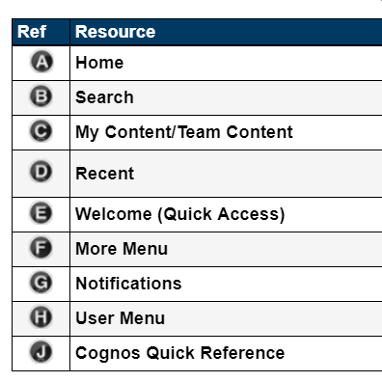
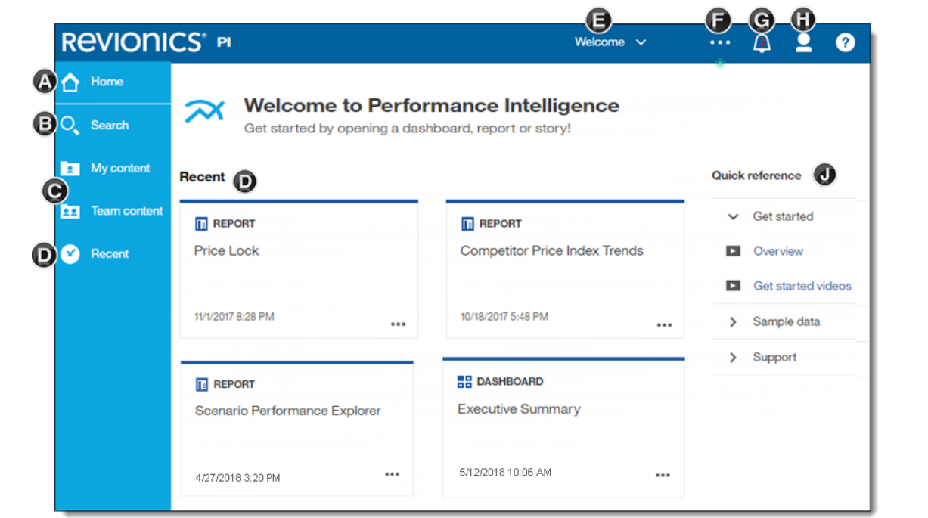
Welcome Page

Slide 6
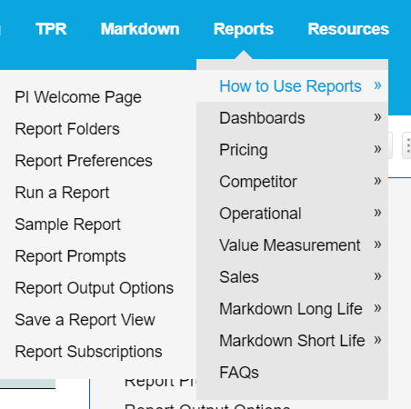
Help Guide
Library of Information Available
Detailed user guide and explanation of reports and methodology

Slide 7
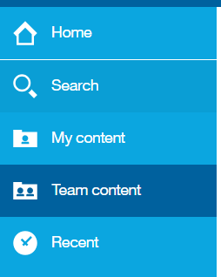
Report Folders
Default Reports Content
Standard reports are in
Team Content> Performance Intelligence
My content is for user saved views
Team content>Custom views for shared views

Slide 8
Running a report navigations
Prompts for criteria and filter selection

Slide 9
Performance Intelligence
Dashboards

Slide 10
Value Measurement by Strategy Dashboard
A – Allows to view revenue, profit, and unit lifts by pricing strategy for a selected week.
B – Options to further break down the analysis by product and for exported prices.
Global Filters (affect all tabs)

Slide 11
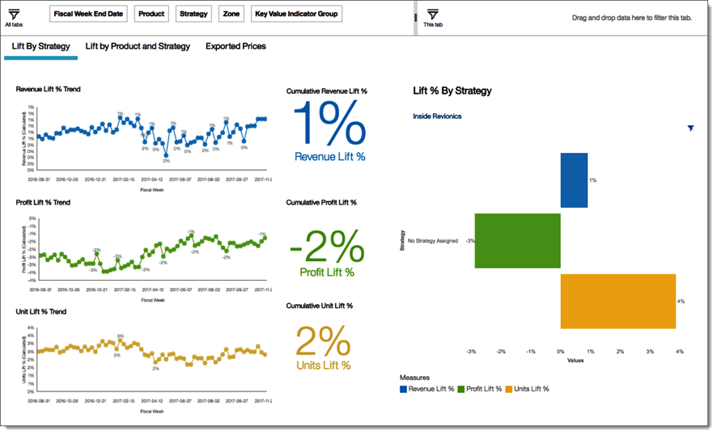
Value Measurement by Strategy Dashboard
View weekly trends and cumulative values for revenue, profit, and unit lift.
On the right, view a breakdown of lifts by the strategies associated with prices exported from Revionics (only one strategy shown in example).
Lift by Strategy tab

Slide 12
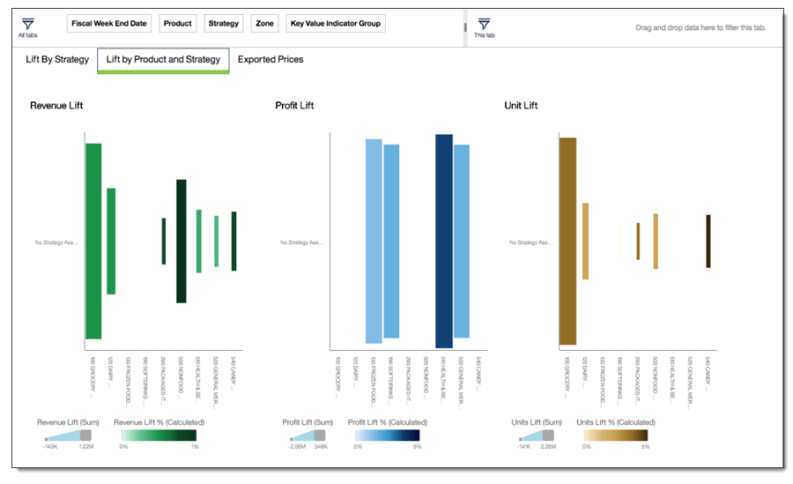
Value Measurement by Strategy Dashboard
Heat map comparison of lifts across product hierarchy nodes and strategies.
Lift by Product and Strategy tab

Slide 13
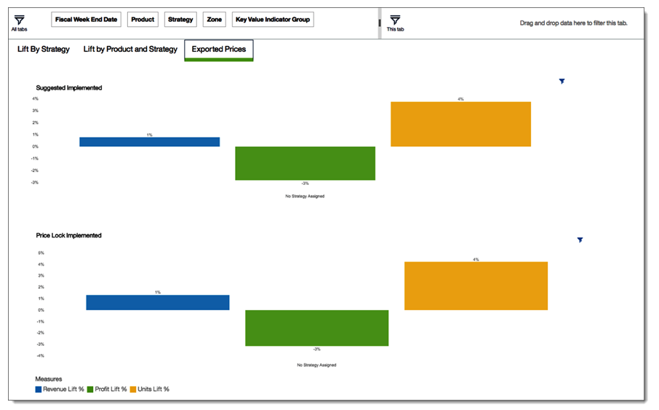
Value Measurement by Strategy Dashboard
Exported Prices tab
Comparison of lifts by strategy for exported prices that were Suggested Implemented versus price locks.

Slide 14
Performance Intelligence
Exports & Compliance

Slide 15
Export Classification
Classification Based on Implementation of Prices
Suggested Implemented
Price Lock Implemented
Inside Revionics
Revionics recommended a price and it was exported and implemented
A price was locked within Revionics using insights from optimization
No Change
A Price may have been recommended but was not exported and was not changed
Not Implemented
Export Overridden
Outside Revionics
Revionics recommended a price and it was exported but never implemented
Revionics recommended a price and it was exported but changed prior to implementing

Slide 16
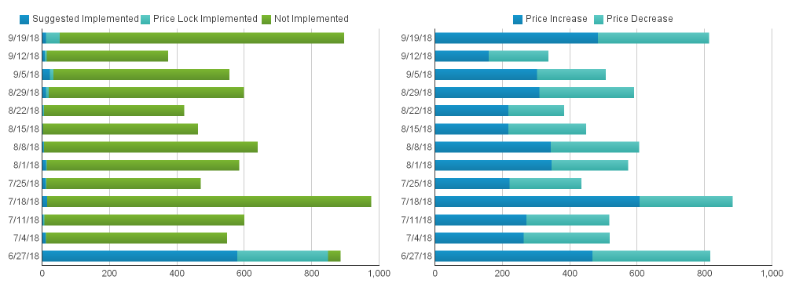
Export Compliance by Acceptance
Trends by Week

Slide 17
Performance Intelligence
Scenario Explorer – Planning

Slide 18
Scenario Explorer
Overview
Compare individual scenarios from a number of different perspectives, evaluate various metrics across these scenarios, and understand how the constituent factors contribute to a scenario’s forecast.
Collection of dashboards that allow evaluation of scenarios within a price model based on:
Financial Impact
Price Change Impact
Pricing Module Impact
Constraint Impacts
Reports help choose the best scenario to maximize your objectives.

Slide 19
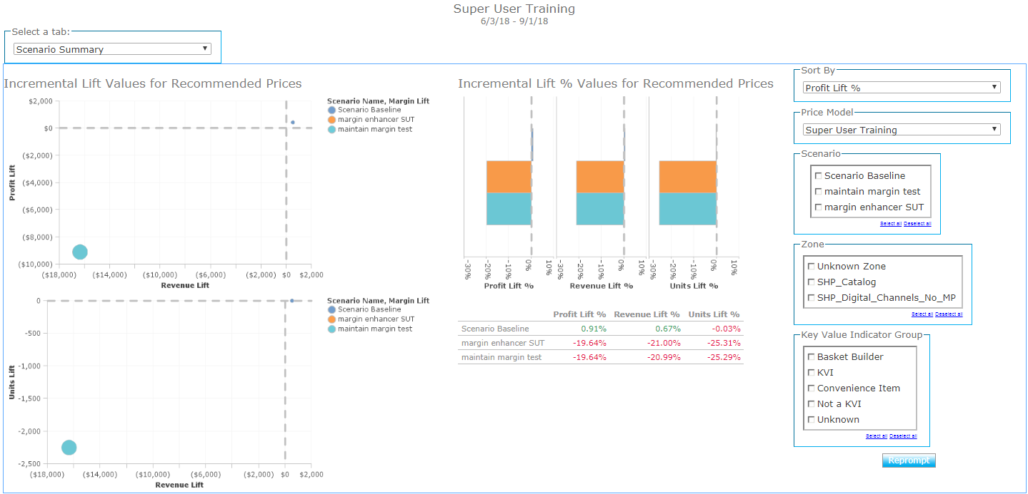
Scenario Summary Tab

Slide 20
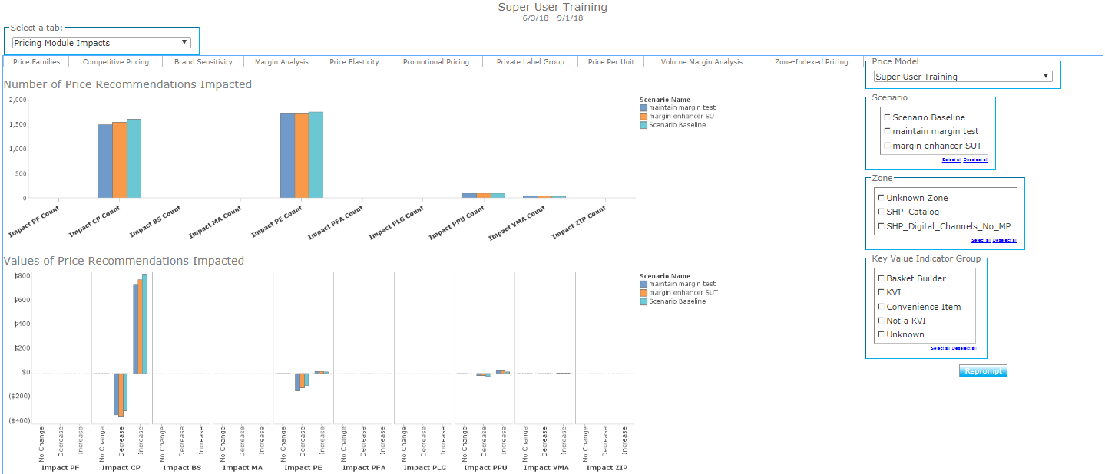
Pricing Module Impact Tab

Slide 21
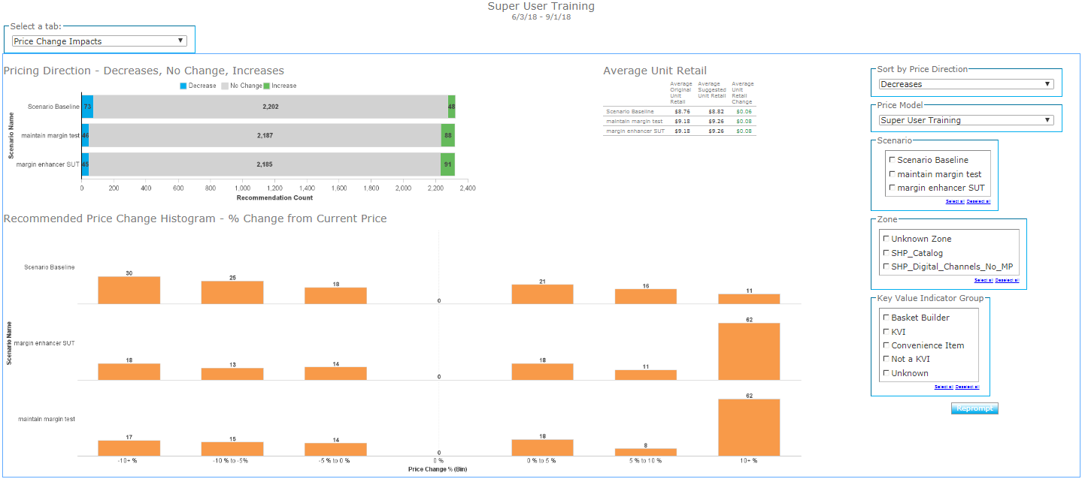
Price Change Impact Tab

Slide 22
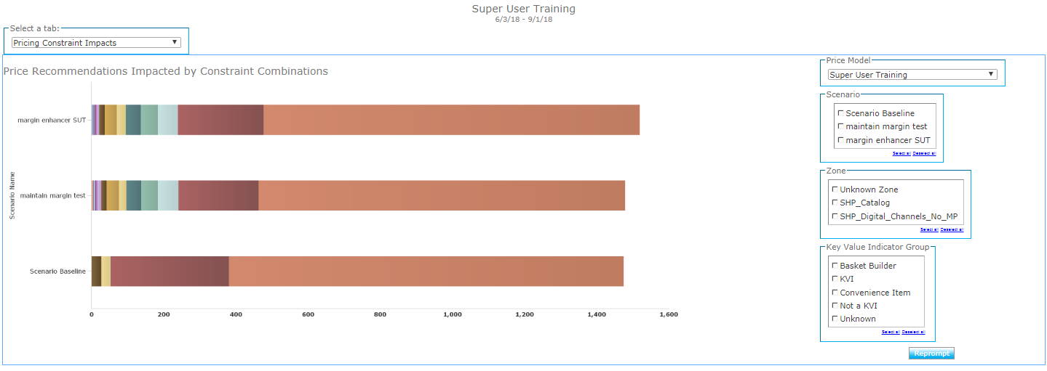
Price Constraint Impact Tab

Slide 23
Performance Intelligence
Value Measurement

Slide 24
Value Measurement Methodology
Building Blocks for the Analyses
Pricing Compliance
Classification of Pricing decisions made
Price Lift Analysis
Measuring ‘lift’ and what impact the price change had
PRICE LIFT ANALYSIS
Price Lift & Compliance
Classification of ‘lift’ into the Compliance buckets
Notes:
Think through combining 3&4

Slide 25
Segments for PLA
Segmented PLA will take the price lift records and divide them into reportable financials based on the logic below
- This will only work for customers using the back office export
- Prices will be reported in four ways using
Inside Revionics
Suggested Implemented
Item price change matches suggested price by Revionics (3 week period)
Price lock Implemented
Item last export record was “price lock implemented” and price matches the exported locked price
Outside Revionics
Export Overridden
Item has a PLA record and was exported at one time but the price does not match the last exported price
Not Exported
Item has a PLA record but has never been exported from Revionics
Segments
Groups
Segments
No Change
Price did not change

Slide 26
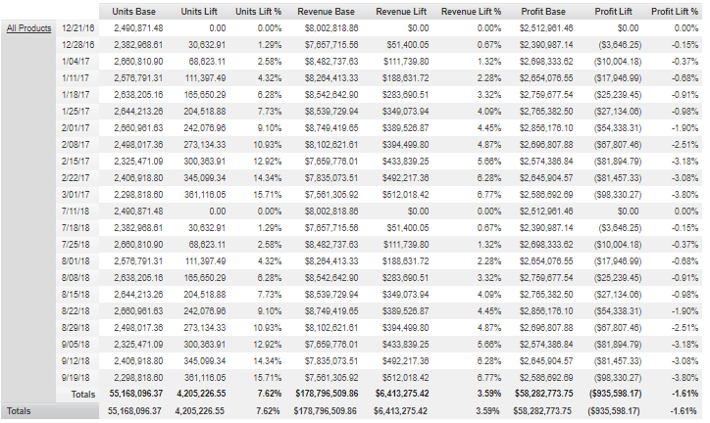
Price Lift Analysis

Slide 27
Segmented Price Lift Analysis

Slide 28
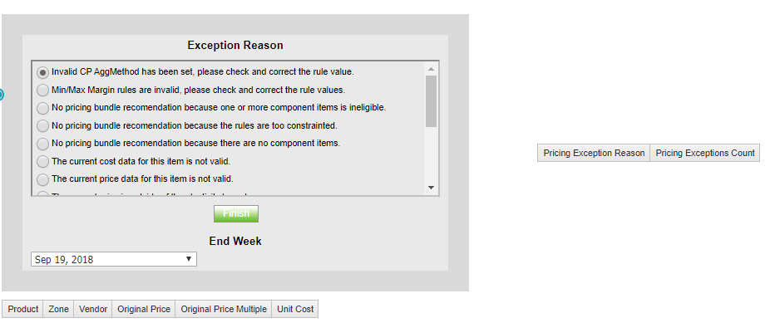
Pricing Exceptions
Items excluded from the portal

Slide 29
Thank You!

Slide 30
Appendix

Slide 31
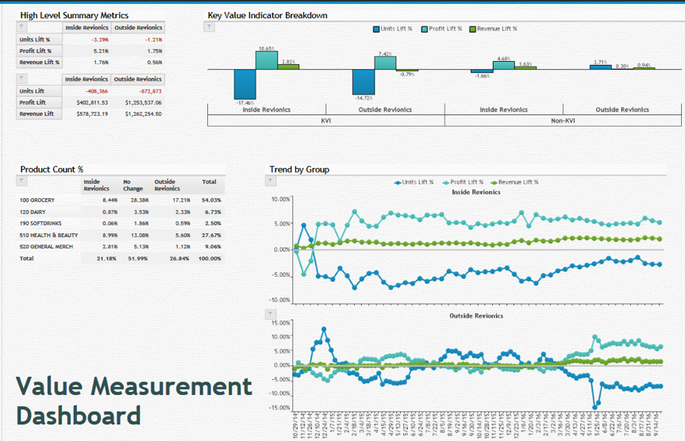
Value Measurement Dashboard
A
C
Build using filter prompts
A – Metrics Summary
B – Product Count % (Inside vs Outside Revionics)
C – Metric performance by KVI non KVI
D – Trend over time (Inside vs Outside Revionics)
B
D

Slide 32
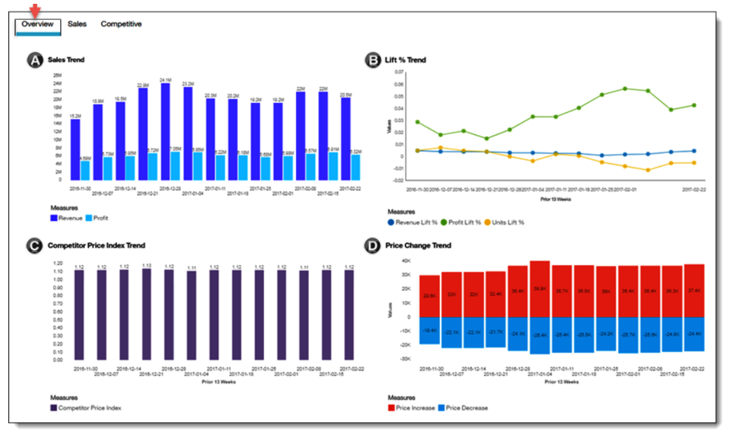
Executive Summary Dashboard
Overview Dashboard
A - Weekly trends of sales metrics comparing revenue and profit.
B - Weekly pricing lift trends for revenue, profit and units in percentage values.
C - Weekly trends of CPI values.
D - Weekly trends of price changes, up and down.

Slide 33
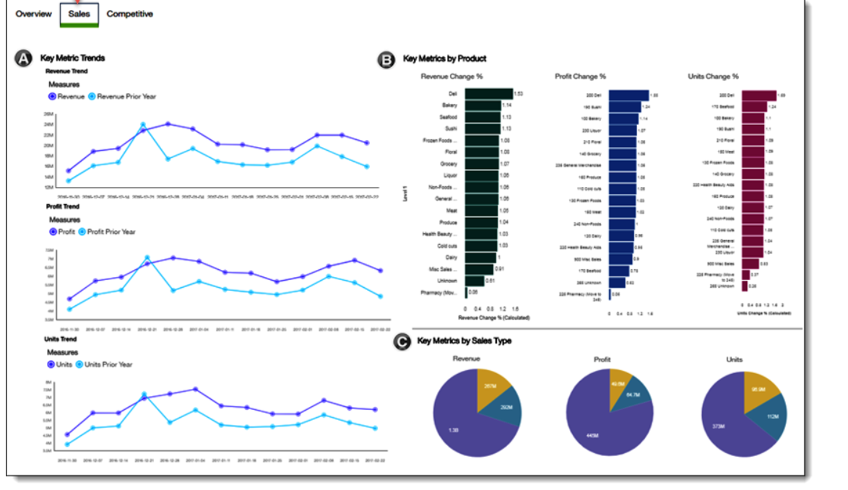
Executive Summary Dashboard
Sales Dashboard
A - Weekly trends of sales metrics comparing revenue and profit.
B - Revenue, profit, and units change percent by product hierarchy.
C - Revenue, profit, and units contribution by sales type.

Slide 34
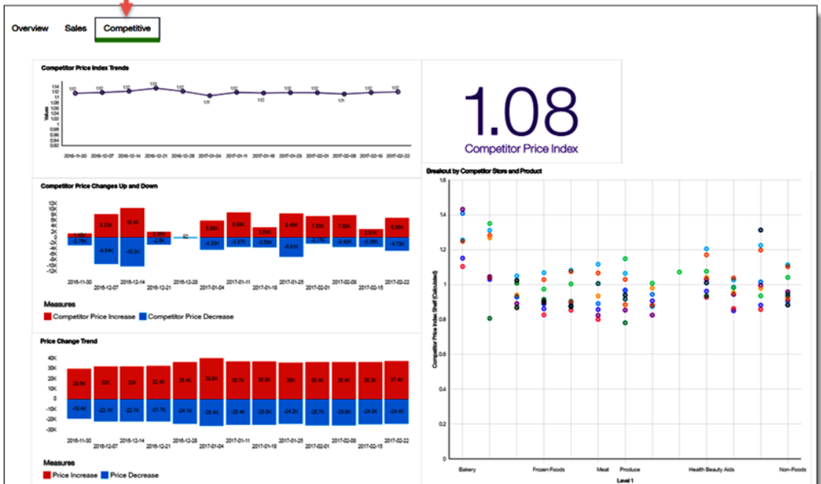
Executive Summary Dashboard
Competitor Dashboard
A – Competitive Index Trends
B – Competitive Index Value for period filtered
C – Competitor price changes up and down
D – Price change trend
E – CPI value by each division (Level 1)
A
B
E
C
D

Slide 35
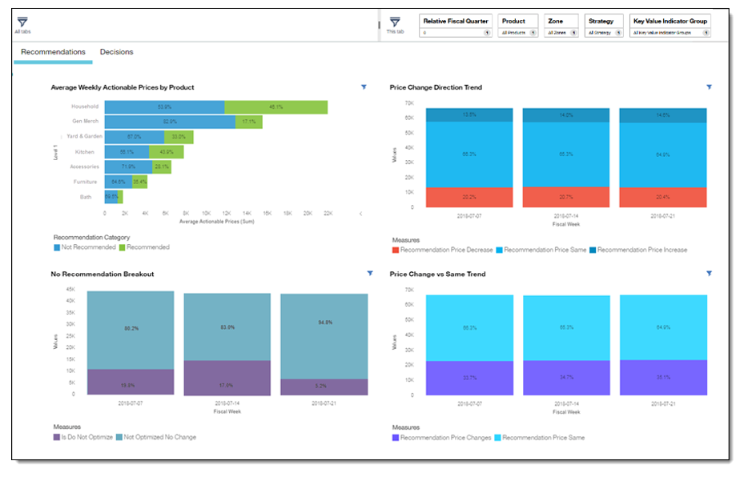
Pricing Decisions Dashboard
Exported versus Recommended Changes
A – Average Weekly Actionable Prices by Product Hierarchy
B – Price Change Direction Trend (Increase, Decrease, No change)
C – No Recommendation Breakout (Is DoNotOptimize vs no change)
D – Price Change vs No Change Trend
A
B
C
D

Slide 36
Appendix: The PLA: Before the Price Change
E₁
Elasticity Calculated
Unit Sales
History
PE Engine makes suggestion using elasticity E₁
The price change impact shown in price review uses E₁ as well
Price
Old Price
Time

Slide 37
Appendix: The PLA After the Price Change
Elasticity Calculated
E₂
History
Post price change the elasticity is recalculated to identify the most recent value (E₂)
Calculated Baseline Units
If No Price Change
Unit Sales
Lift
Actual Units
Price Change
Today
(date of measurement)
This updated value is used to calculate baseline units
Price
New Price (Increase)
Time

Slide 38
Appendix: The PLA: Measuring a Forecast?
All variables are known during the measurement period
Calculated Baseline Units
If No Price Change
Lift
Actual Units
The elasticity value related to the actual price change is known
Baseline value is calculated at time of measurement --backwards
Known Elasticity = Known Impact

Slide 39
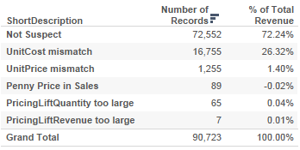
Appendix: Suspect Data
Example data
Unit Cost Mismatch → Unit Cost Mismatch between Client.Sales and Client.PriceCostPrimaryVendorHistory
UnitPrice mismatch → Unit Price Mismatch between Client.Sales and Client.PriceCostPrimaryVendorHistory
Penny Price in Sales → Penny Price in Client.PriceCostPrimaryVendorHistory
Pricing Lift Quantity is greater in magnitude than Actual Quantity → Rows where ABS(PricingLiftQuantity) are greater than the Sales Quantity
Pricing Lift Revenue is greater in magnitude than Actual Revenue → Rows where ABS(PricingLiftRevenue) are greater than the Sales Revenue

Slide 40
Appenxix: Export Compliance
3 Week window for Implemented Price Change
Using a 3 week window this is how items would be captured to show that price changes exported are implemented in the stores.
The Gray item in week 7 would not be included in any implemented buckets because it was implemented after the 3 week window. This item would be categorized as “not implemented”

Slide 41
Hints & Tips
Signing out correctly
Pop ups required
Customize Language
Save to Excel

Slide 42
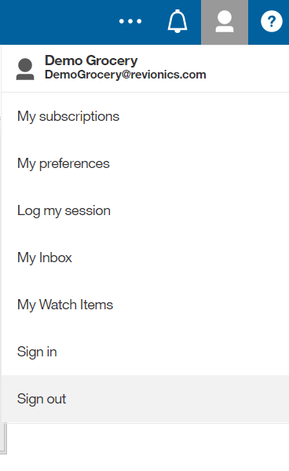
Hints & Tips
Signing out correctly
Always sign out of a session rather than close window
Prevents account cache errors on next sign in

Slide 43
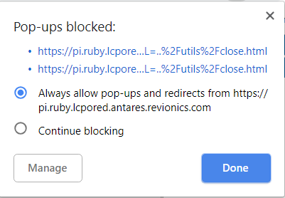
Hints & Tips
Pop up blockers
Dashboards open in a new window
This requires pop ups to be ‘always allowed’ for this site

Slide 44
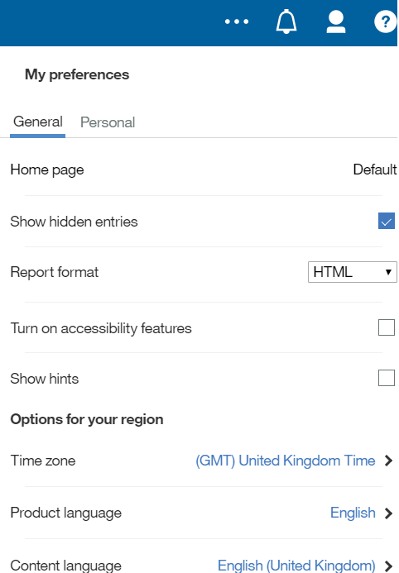
Hints & Tips
Customize content to local language
Content of language and currency symbols can be customized within preferences
This includes the Price change history tab and Units tab (PI Reports in base pricing)

Slide 45
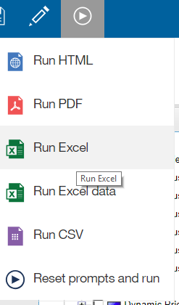
Hints & Tips
Save to excel for customized analysis
Export data and graphs to excel
Unhide tabs to see raw data behind graphs

